Slide 1
Digital Portfolio
STUDENT NAME:SUJITH BALAJI K
REGISTER NUMBER:24BCS133
NMID:asbru001224BCS133
DEPARTMENT:COMPUTER SCIENCE
COLLEGE:GOVT ARTS COLLEGE,COIMBATORE

Slide 2

PROJECT TITLE
PERSONAL DIGITAL PORTFOLIO

Slide 3


AGENDA
Problem Statement
Project Overview
End Users
Tools and Technologies
Portfolio Design and layout
Features and Funtionality
Results and Screenshot
Conclusion
Github link

Slide 4
PROBLEM STATEMENT
Students often lack a professional and organised way to
Showcase their skills,achievements,and project online.
A Digitial portfolio helps present these in a structured and attractive manner.

Slide 5

PROJECT OVERVIEW
This project is a simple digital portfolio website
Designed to highlight academic background,skills,
Projects,and contact details.t serves as an online resume and carrer identity.

Slide 6

WHO ARE THE USERS?
Students(to showcase skills & projects)
Recuirement(to evaluate canditates)
Teachers & mentors(for academic reference)

Slide 7

TOOLS AND TECHNIQUES
HTML5-Structure
CSS3-Styling
JavaScript-interactivity
GitHub-Hositng & version control

Slide 8
PORTFOLIO DESIGN AND LAYOUT
Homepage with introduction
About me section
Skills & Projects showcase
Contact details
Simple,clean,mobile-friendly design.

Slide 9
FEATURES AND FUNCTIONALITY
Responsive design (works on mobile & desktop)
Easy navigation menu
Showcase of academic & personal projects
Contact form / links to email & Linkedln

Slide 10
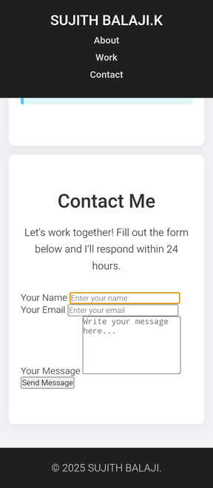
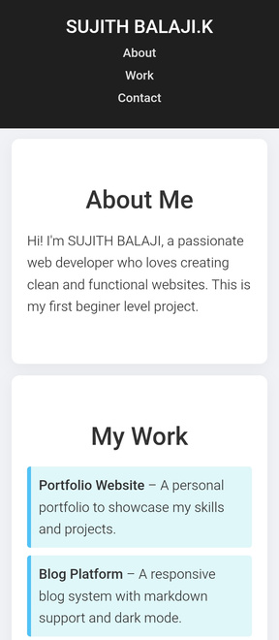
RESULTS AND SCREENSHOTS

Slide 11

CONCLUSION
The digital portfolio provides a professional way to
Present achivements and projects online,making it
Easier for recruiters and institutions to evaluate canditates.

